Slide 1
Supervised Learning
09/16/18

Slide 2
What is Supervised Learning?
Teach the model using training data that is already is already labeled with the correct output
Regression
Used to model a target value based on independent predictors
Most regression techniques will differ based on the number of predictors/relationship between the explanatory and response variables

Slide 3
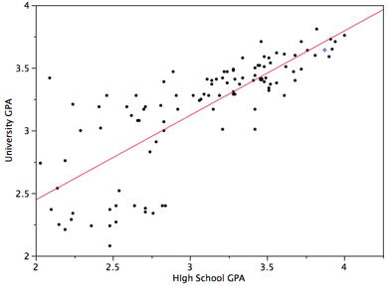
Linear Regression
y = b + wx
Finding the best line to fit two attributes so that one attribute can be used to predict the other
Multiple linear regression uses more than two attributes and the data is fit to a multi-dimensional surface
Correlation not causation

Slide 4
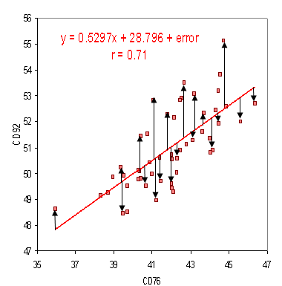
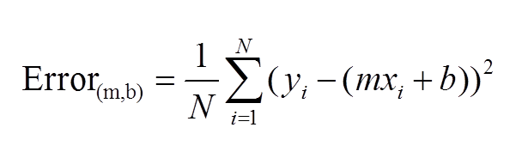
Error Calculation
Residuals
The distance between the observed and expected value
Mean Squared Error
Also known as the cost function
Helps determine the best values for w and b to get the best fit line
Minimize the error between observed and expected values

Slide 5
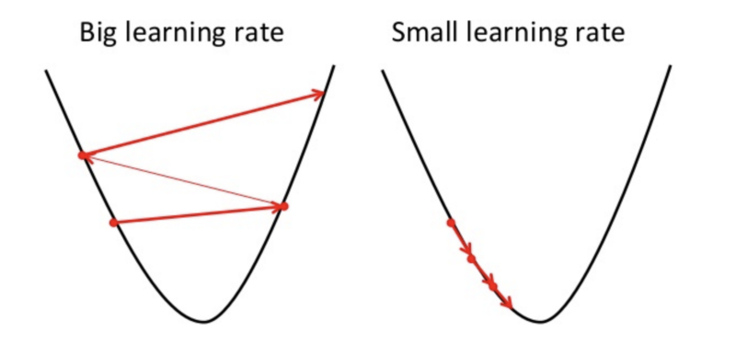
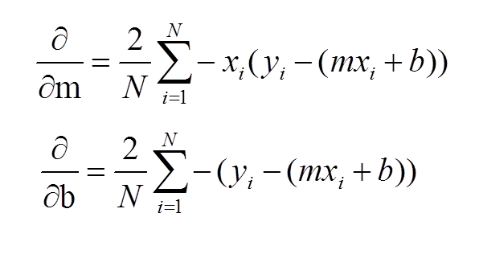
Gradient Descent
Optimization technique
Iteratively updates b and w to reduce the MSE
Taking the gradient of a point acts like a compass and points to the local minimum for a fixed number of steps/until an error threshold is met
Learning rate = how large of a step we take downhill

Slide 6
Assumptions
Data that has:
Linearity between the variables - check with a scatter plot
Constant variance of residuals - no patterns in the residual plots
Normality - the residuals follow a normal distribution and aren’t skewed
Independence - if the predictors are highly correlated they can weaken the prediction power of the model

Slide 7
Limitations
Computationally intensive for high dimensional data
Outliers can affect the prediction strength significantly

Slide 8
Example
Consider predicting the university gpa of students, based on their high school gpa
University GPA = 0.675x + 1.097
If X is 3.1
University Gpa = 0.675*(3.1) + 1.097
= 3.19

